Slide 1



DIGITAL
VALIDATOR/SIGNER
TRUSTED HUB SERVICE PROVIDER APPLIANCE QSCD
MOBILE-ID TECHNOLOGIES & SERVICES JOINT STOCK COMPANY
Level 9, Thuy Loi 4 Building, 286-288 Nguyen Xi Street, Ward 13, Binh Thanh District, HCM City
028 3622 2982
info@mobile-id.vn

Slide 2




CONTENTS
Overview & Pursuant to Decision 2345
System Topology
User Experience And Workflow
Advanced Features

Slide 3


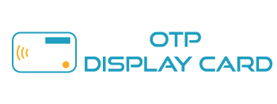









Trusted Hub Overview
”
TRUSTED HUB, HUB FOR VALIDATORS AND SIGNERS

Slide 4



Pursuant to Decision 2345
Level B
Supported
Unsupported
Method
Individual
Organization
OTP SMS
Matrix Card
Basic Mobile OTP
Basic Hardware OTP
Out Of Band
Biometric
Advanced Hardware OTP
UAF/U2F
PKI

Slide 5
Pursuant to Decision 2345
Level C
Supported
Unsupported
Method
Individual
Organization
Basic Mobile OTP
Basic Hardware OTP
Out Of Band

Slide 6
Pursuant to Decision 2345
Level D
Supported
Unsupported
Method
Individual
Organization
Advanced Hardware OTP
UAF/U2F
PKI

Slide 7

SYSTEM TOPOLOGY
Trusted Hub Topology
Trusted Hub API

Slide 8
Trusted Hub Topology
External service
Email
SMS
CA distribution point (OCSP/CRL)
Firebase
Endpoint
SMPP
CA ExternRA webservice
(Optional for CMP)
Banking service
Internet Banking
Service Bus
Trusted Hub Application
Database
Mobile Banking
HSM

Slide 9
Trusted Hub Topology
1
Engine: SOAP and RESTFul
2
Security: Client certificate authentication, IP Filter, Functional Access Manager, RESTful with AWS Signature V4 protocol
3
Feature: Multiple-channel, messaging-mode (SYNC, CLIENT-SERVER ASYNC, SERVER-SERVER ASYNC)

Slide 10
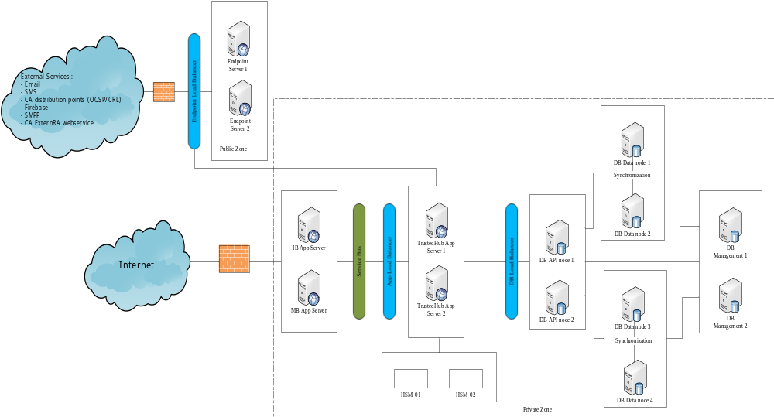
Trusted Hub API

Slide 11
USER EXPERIENCE & WORKFLOW

Slide 12

Download CheckID Client App and start App when experience demo EIDBANK Website

Slide 13
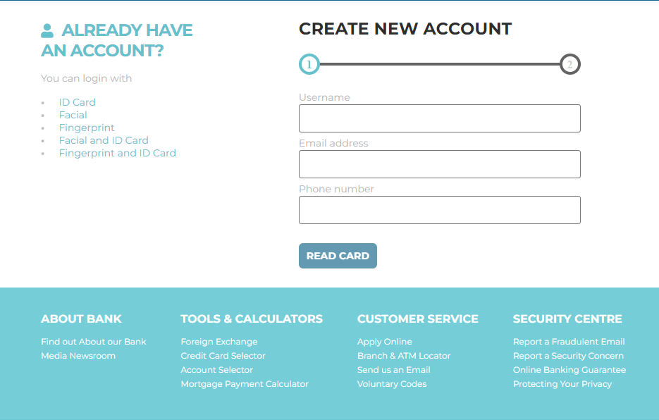
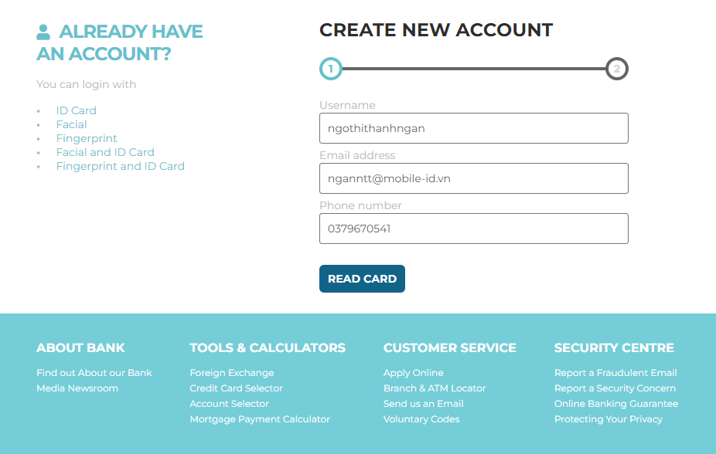
Notes:
Để tạo tài khoản, nhấn “Create an Account” và thực hiện các bước theo hướng dẫn.

Slide 14
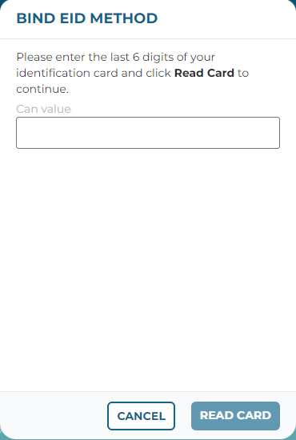
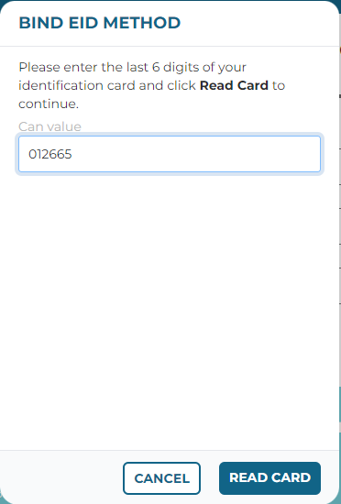
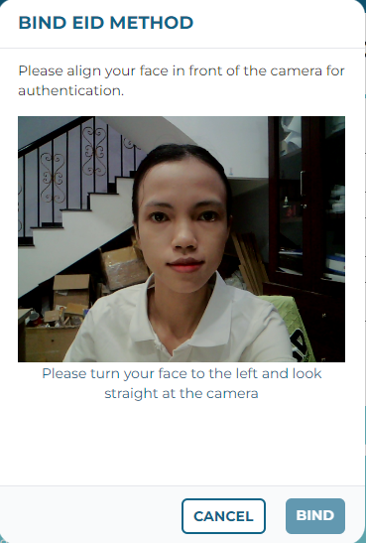
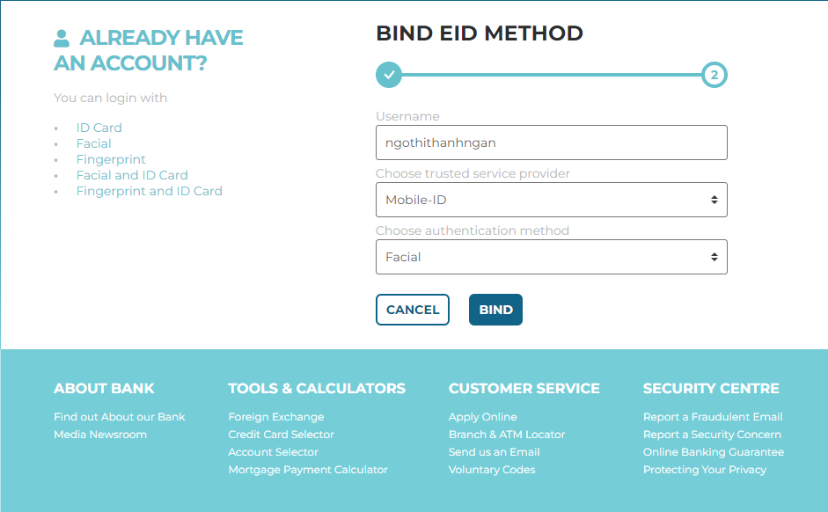
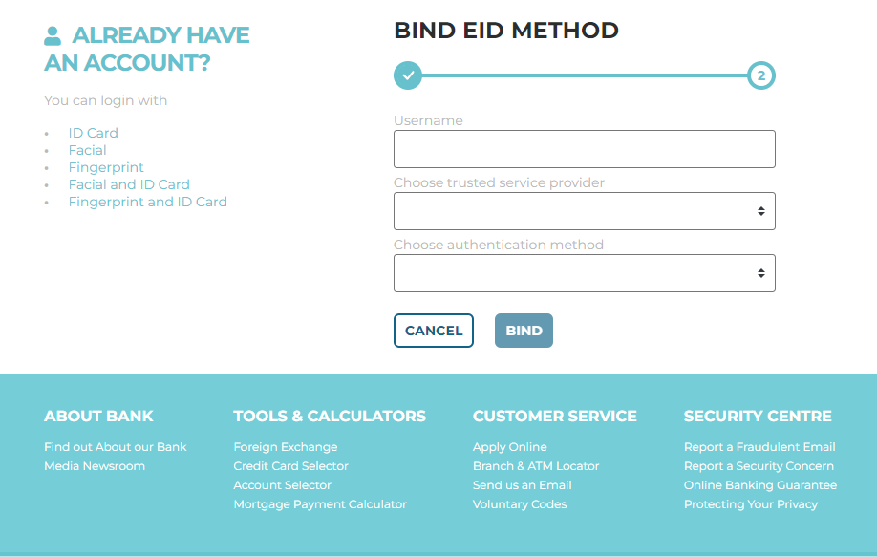
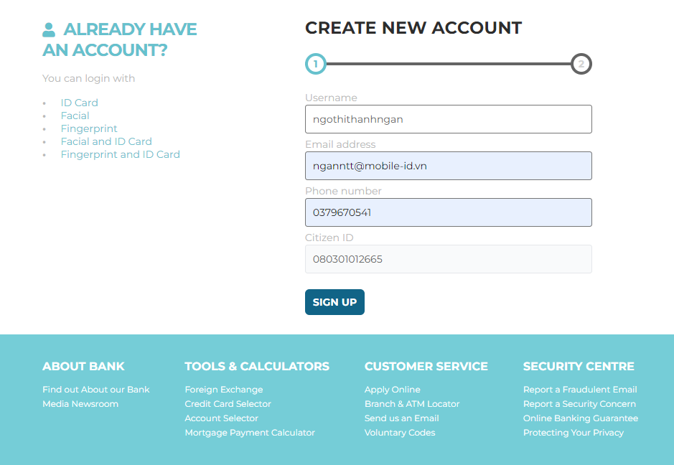

Slide 15

Entered User name, and then choose one of authentication methods and login
Notes:
Nhập Username và Chọn phương thức. Sau đó bấm Login, tiến hành xác thực. Có 5 phương thức xác thực:
ID Cart: Xác thực bằng Đọc thẻ
Facial: Xác thực bằng khuôn mặt
FingerPrint: Xác thực bằng vân tay
Facial & ID Cart: Xác thực bằng Đọc thẻ và xác thực bằng khuôn mặt
FingerPrint & ID Cart: Xác thực bằng Đọc thẻ và xác thực bằng vân tay

Slide 16
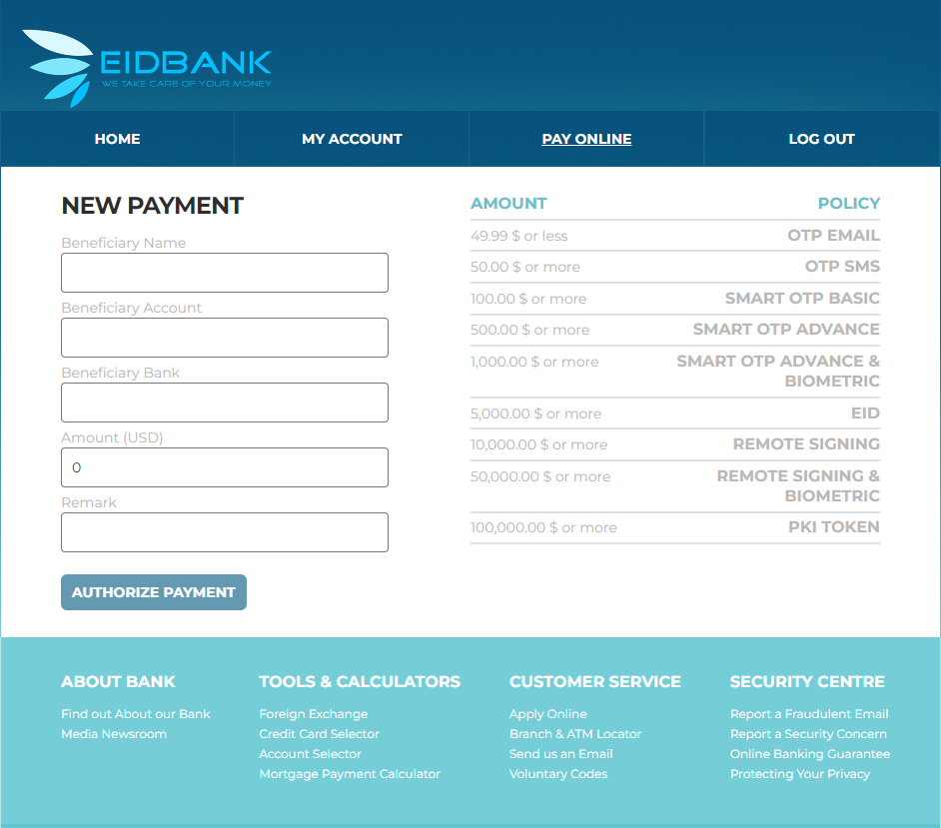
Notes:
Tùy vào giao dịch với mức thanh toán chi phí khác nhau (từ <= 49,99$ đến >=100,000.00$) thì sẽ có phương thức xác thực tương ứng.

Slide 17

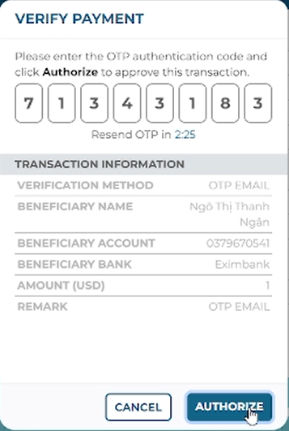
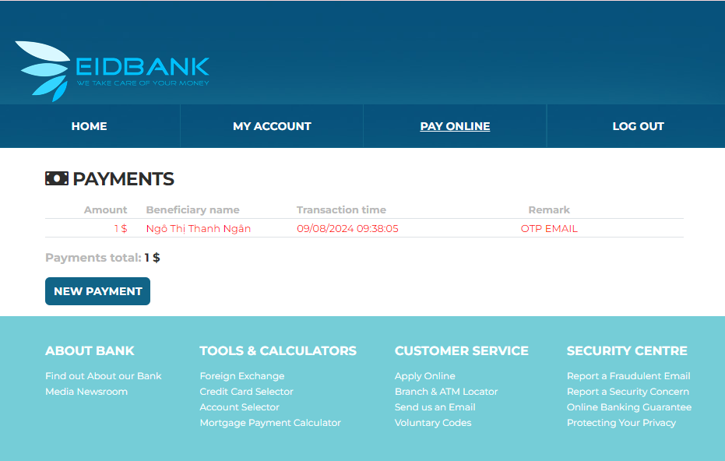
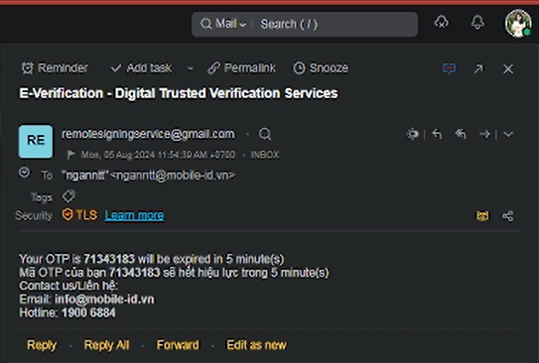
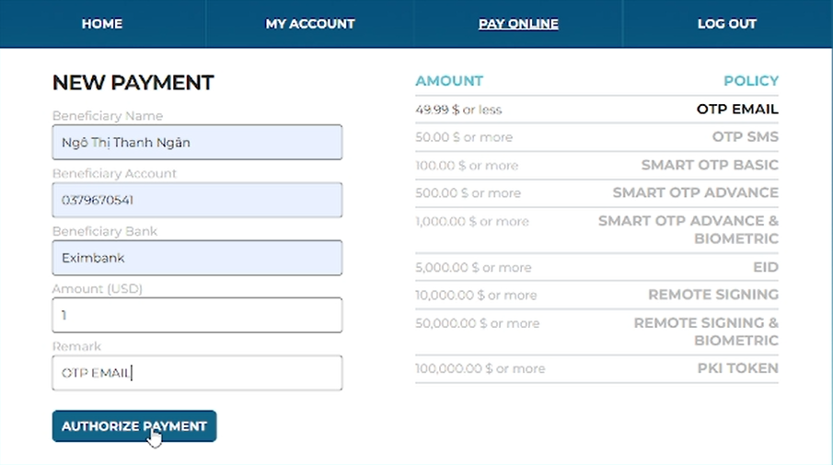
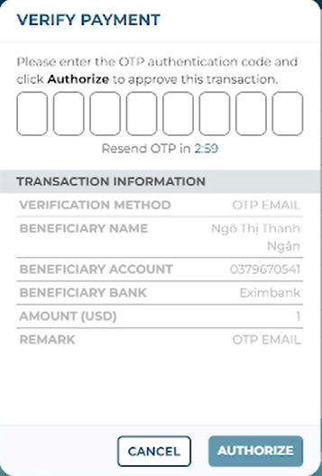

OTP EMAIL
Pay online: 49.99$ or less
Telco
TRUSTED HUB
e-Banking (IB/MB)

Slide 18
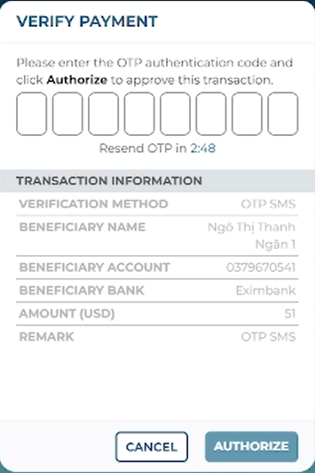
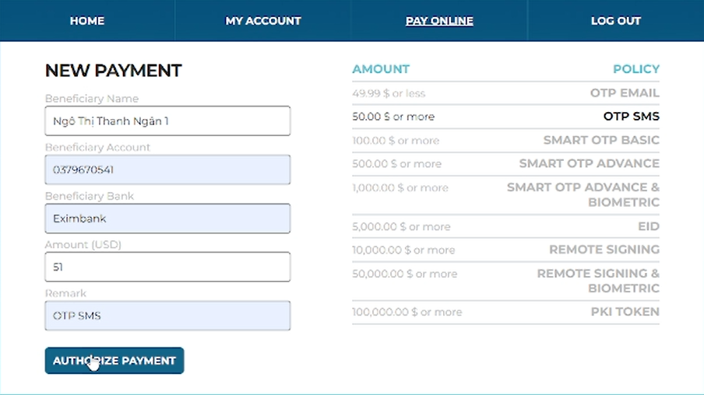
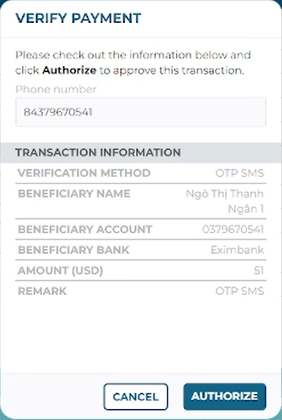
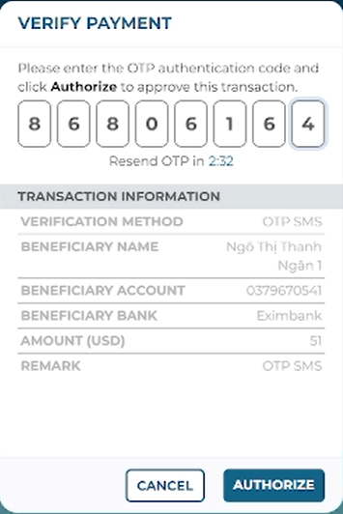
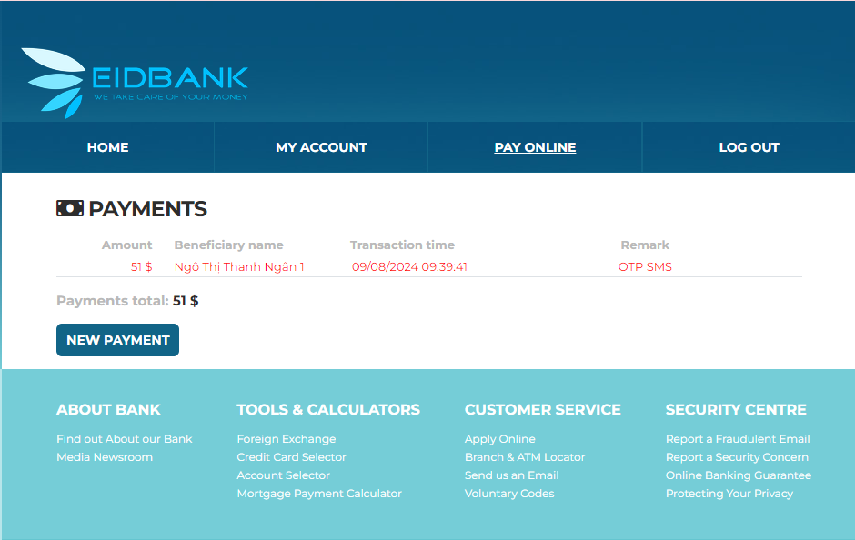
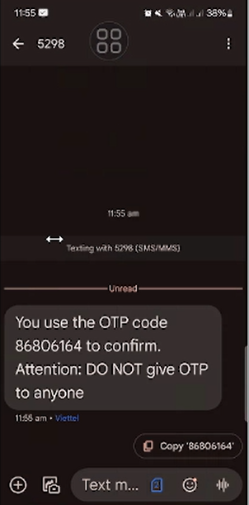
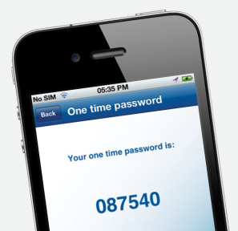
OTP SMS
Pay online: 50.00$ or more
Telco
TRUSTED HUB
e-Banking (IB/MB)

Slide 19

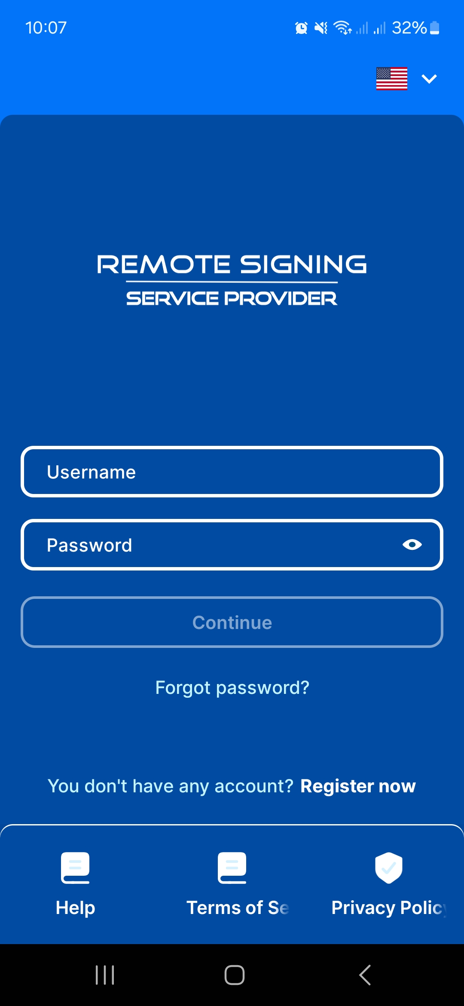
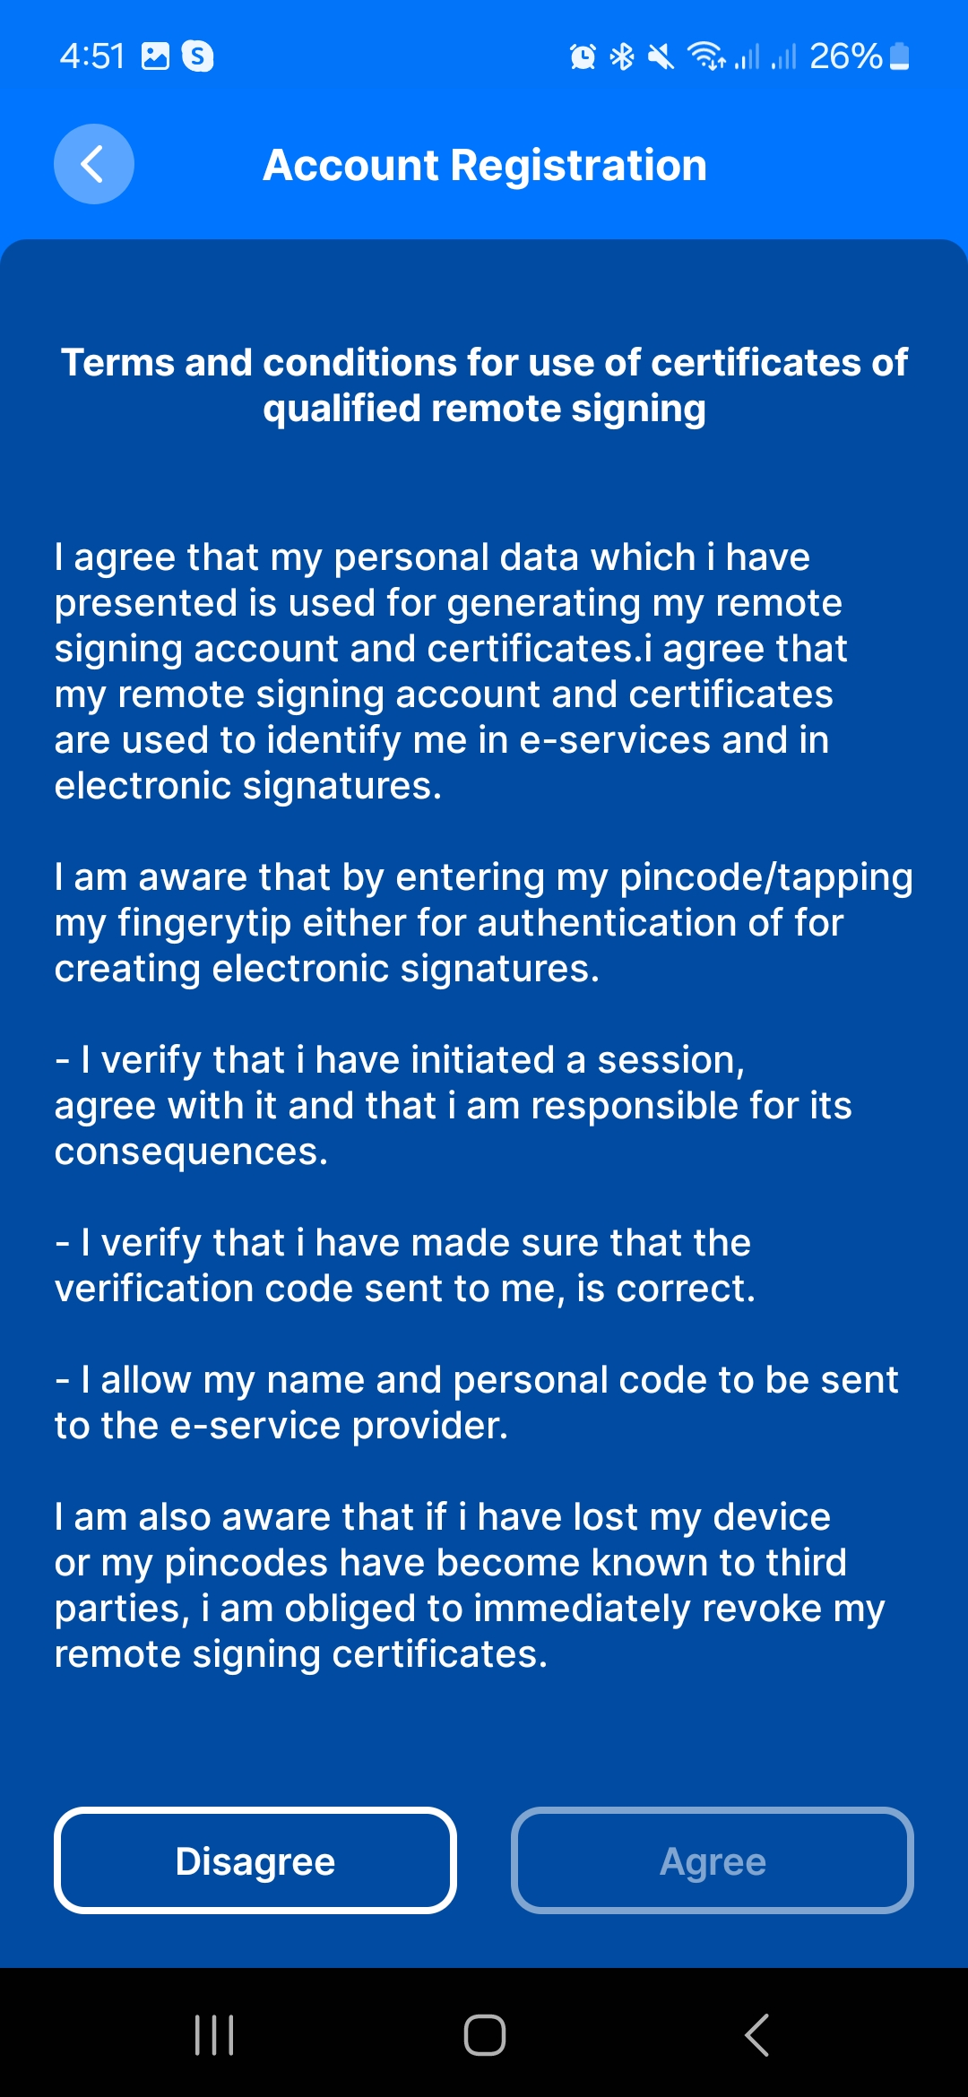
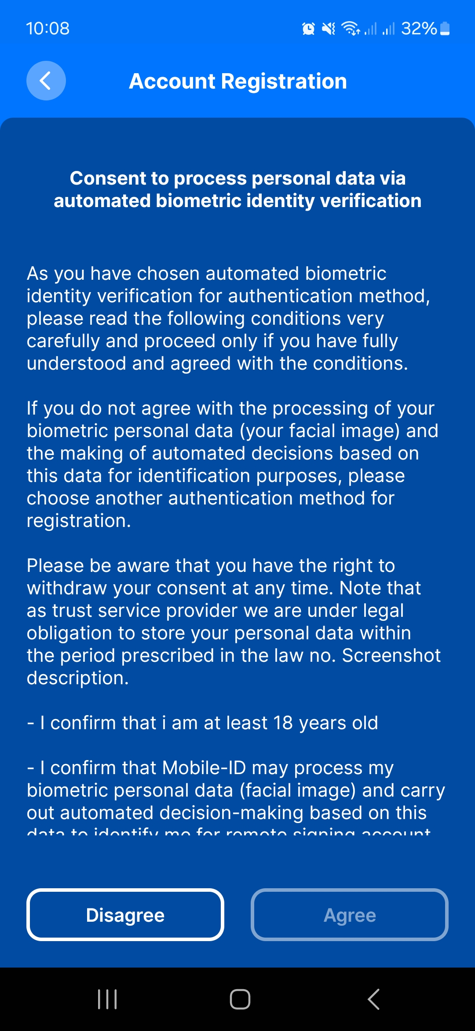
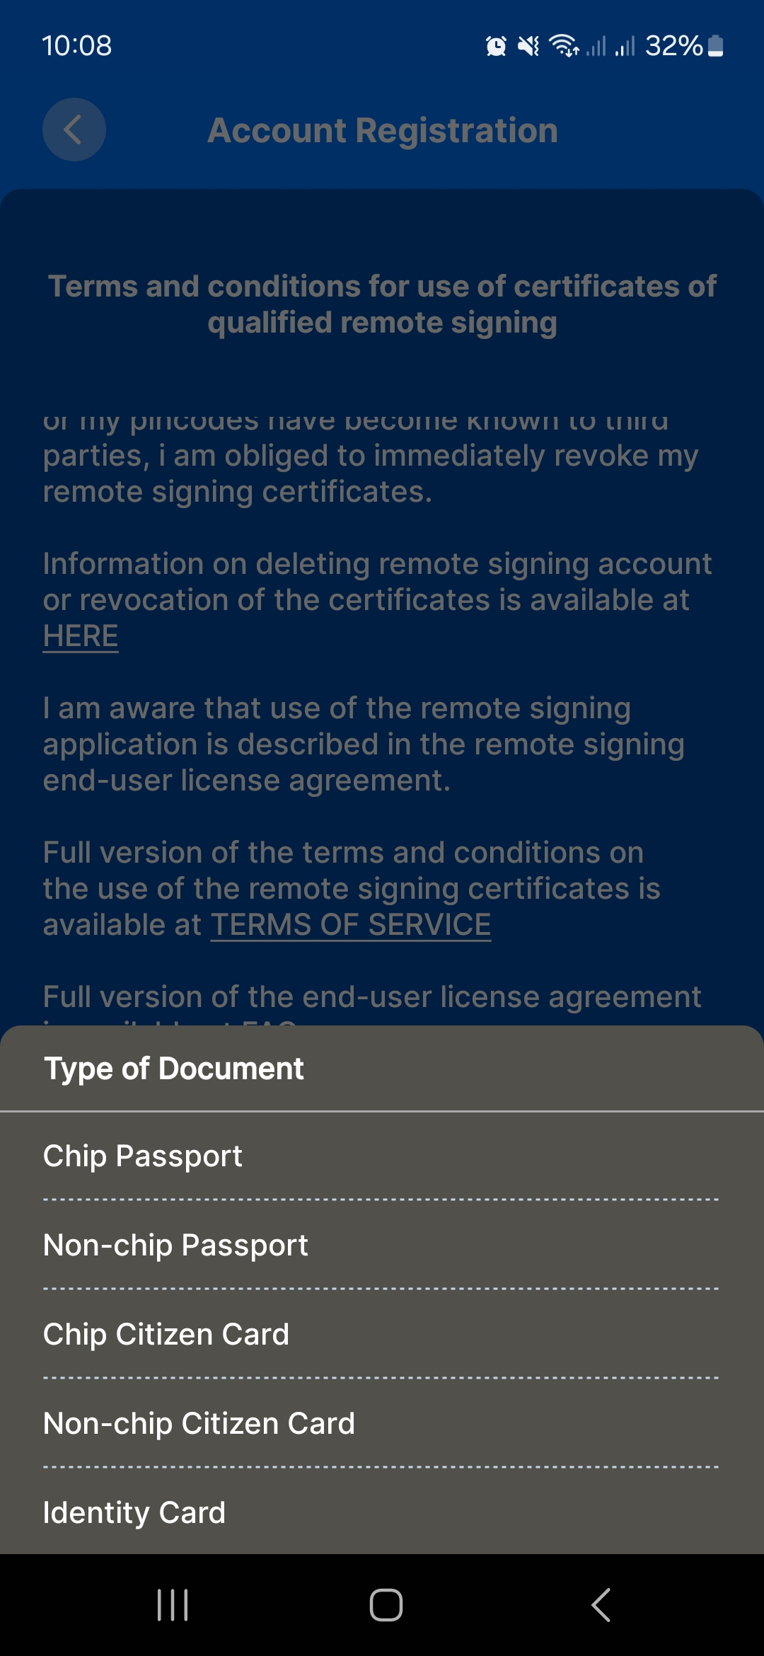
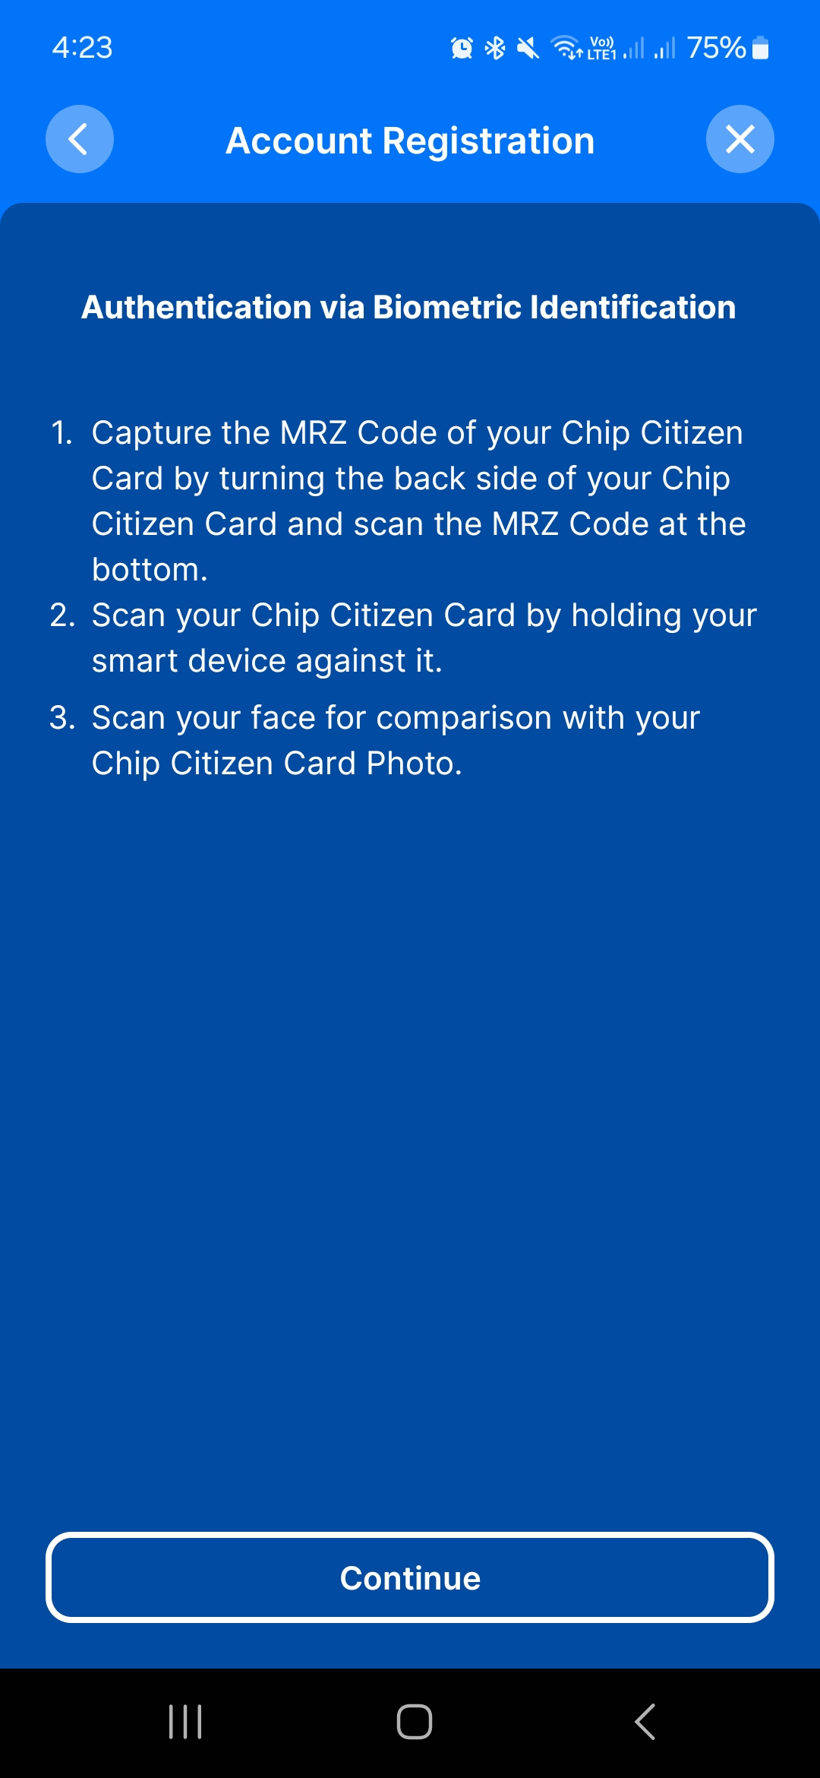
CREATE AN ACCOUNT ON EIDBANK MOBILE APP
Download the Mobile-ID MPKI App on your smartphone and create an account

Slide 20
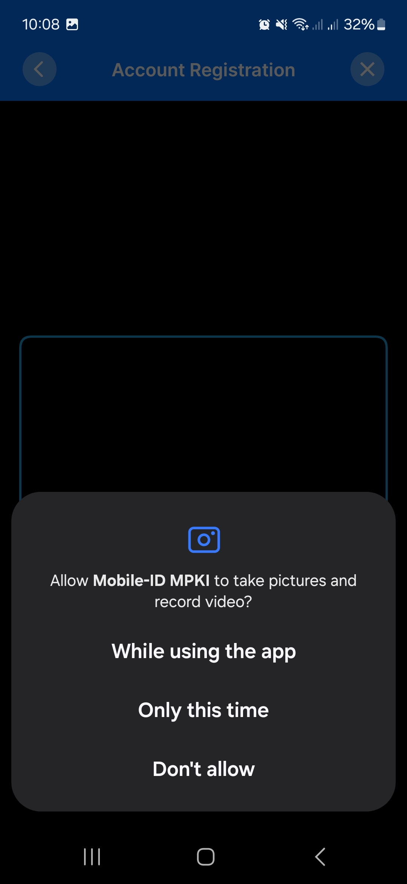
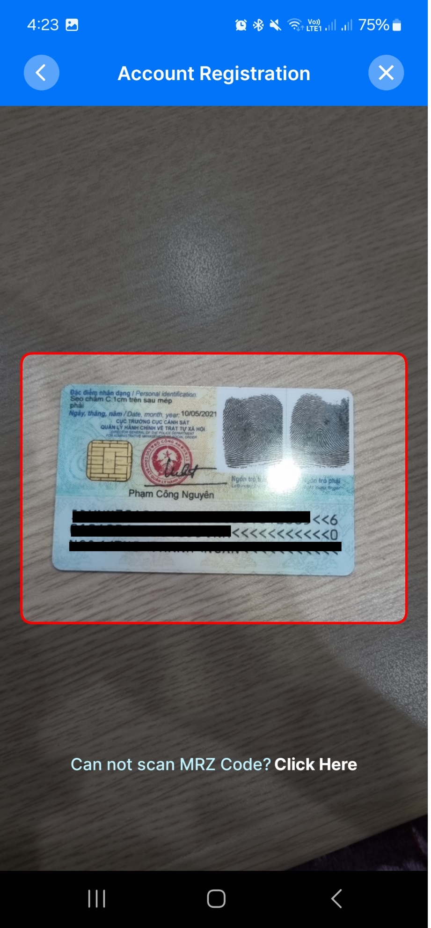
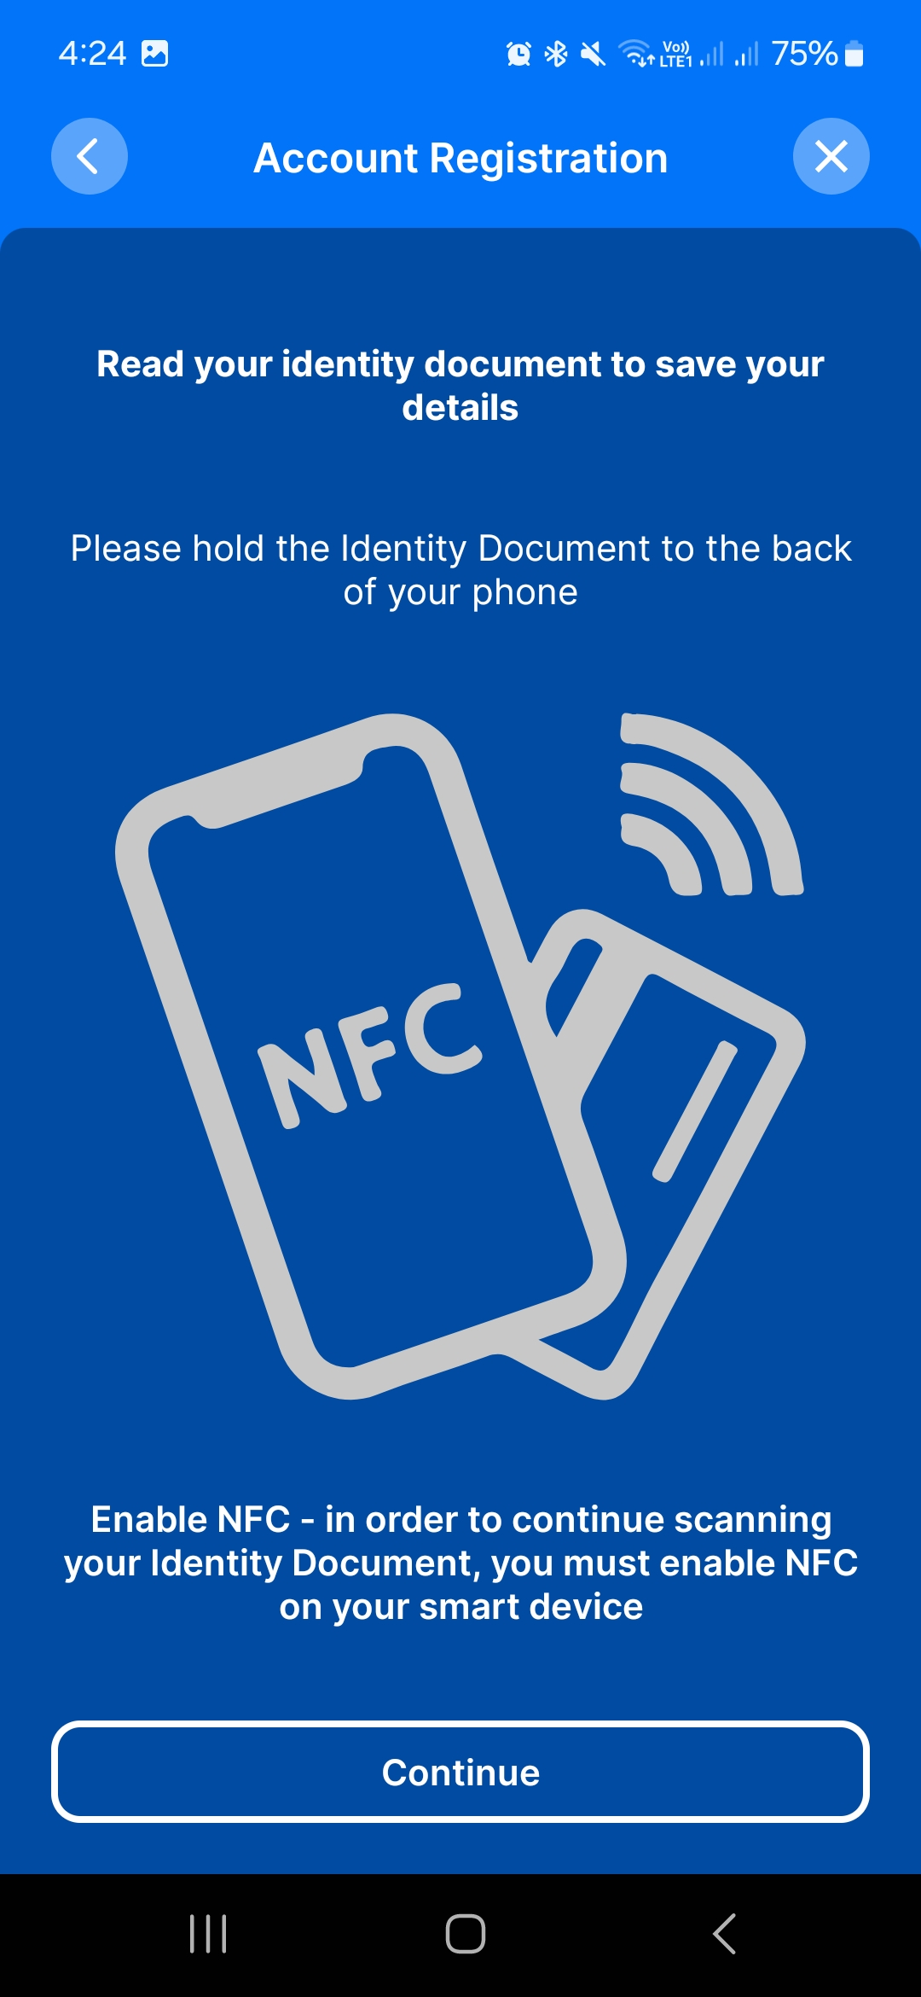
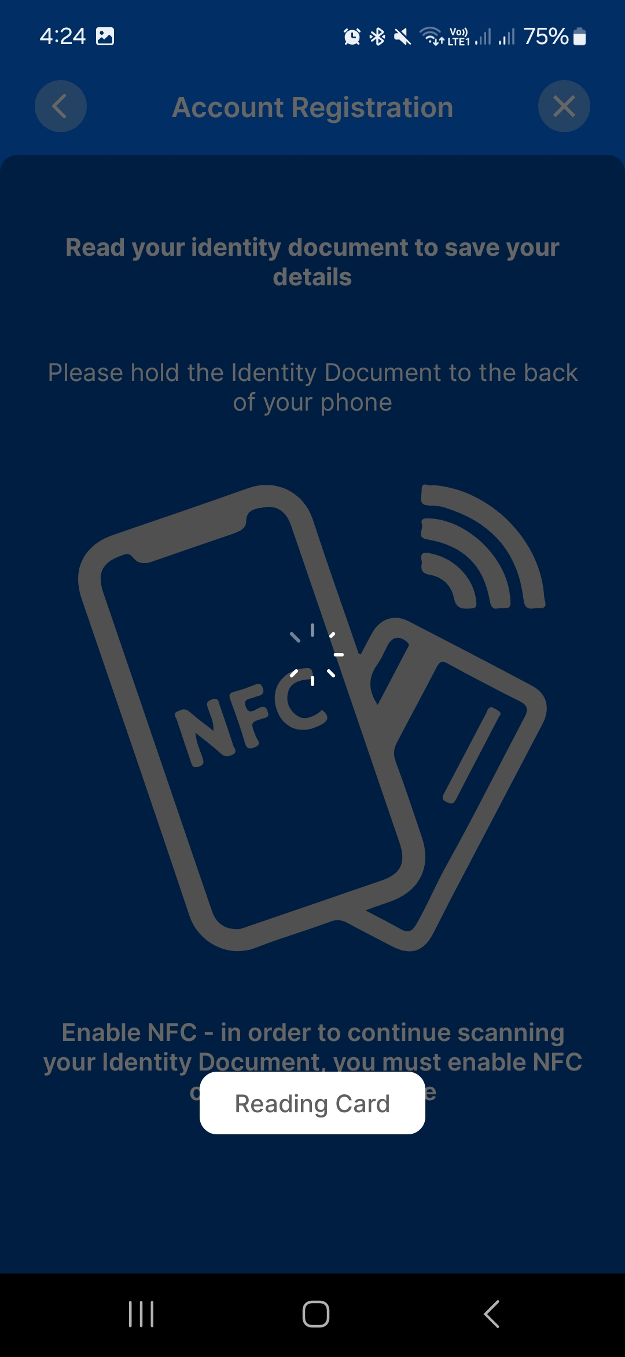
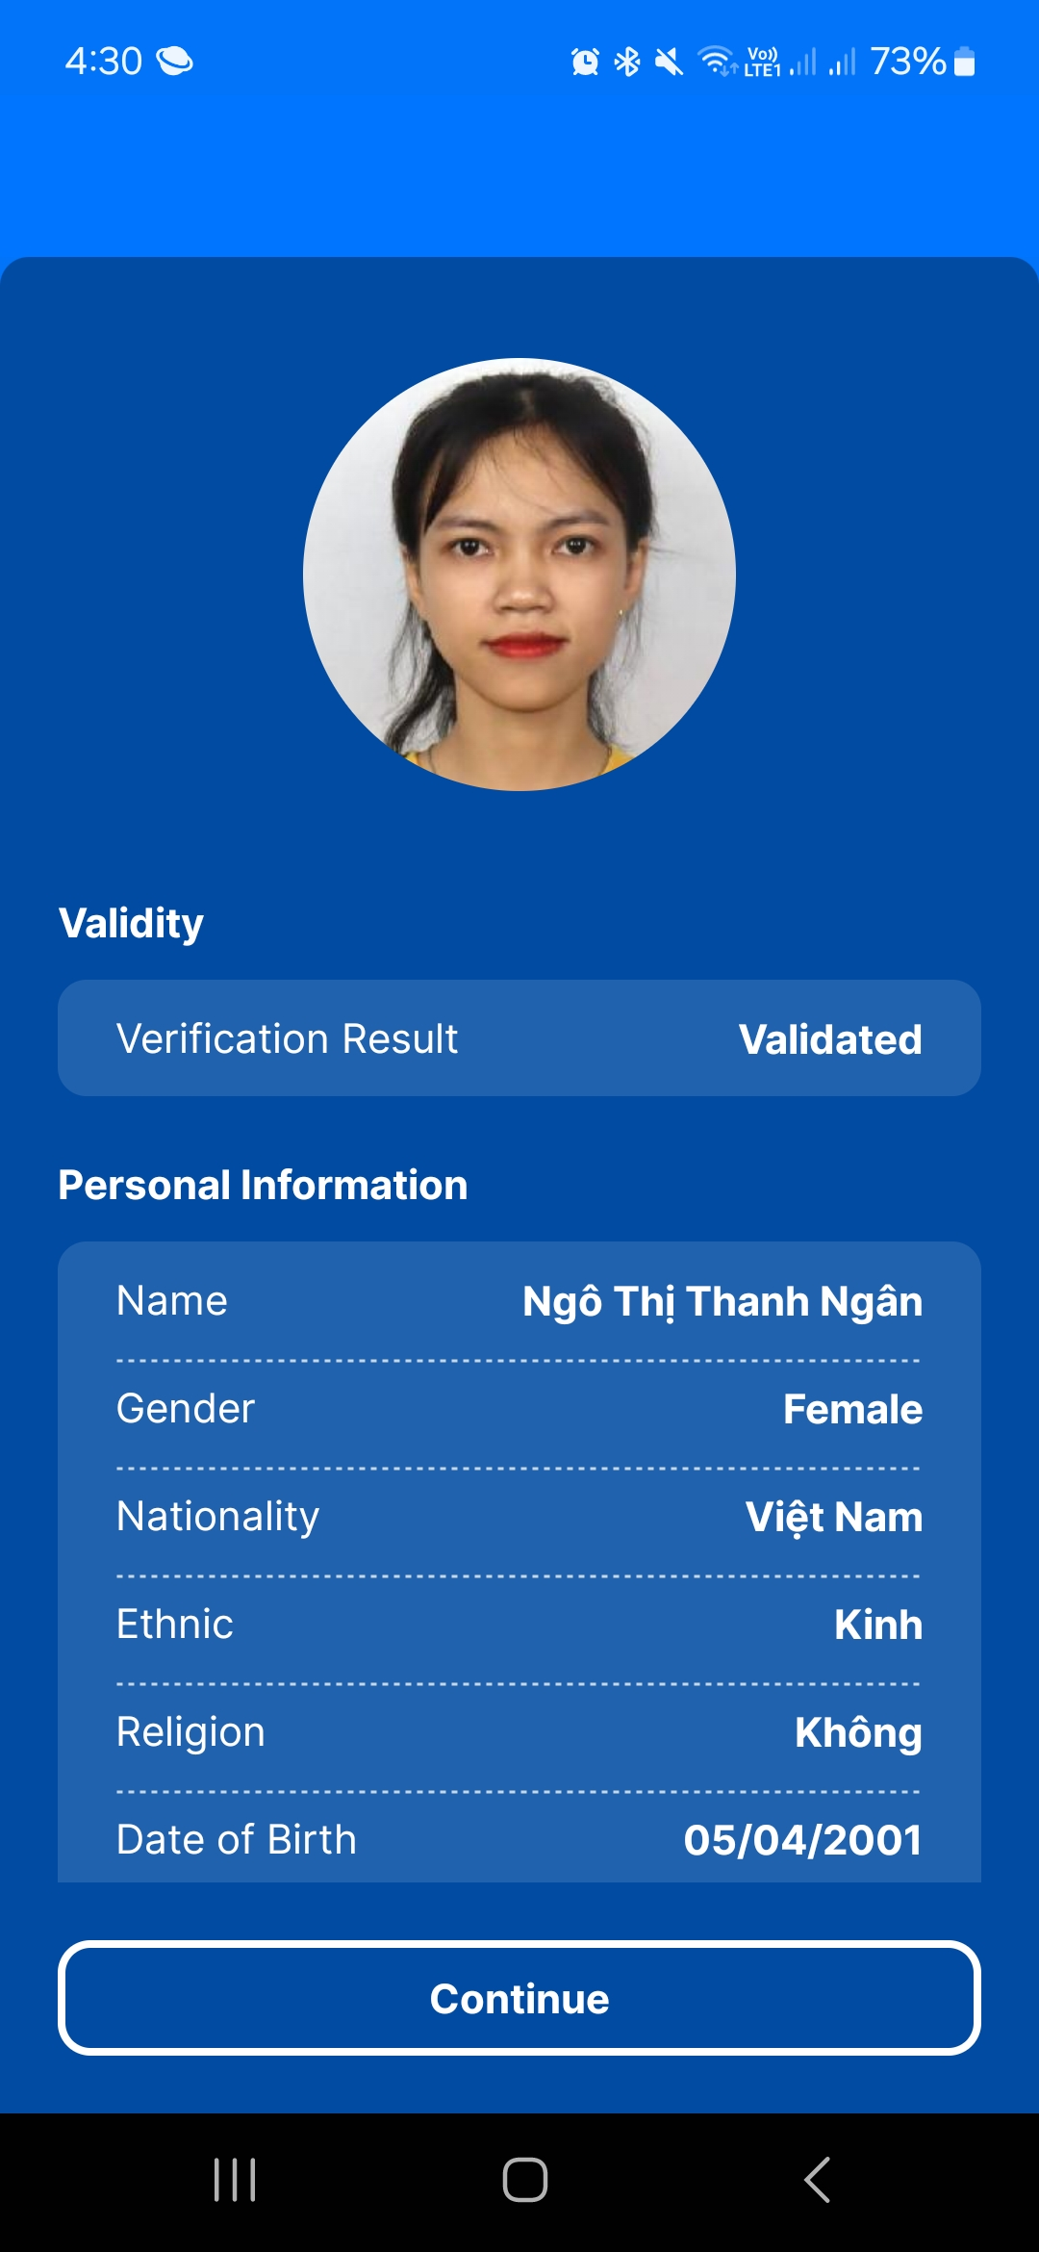
CREATE AN ACCOUNT ON EIDBANK MOBILE APP
Create step by step follow to the App instruction

Slide 21
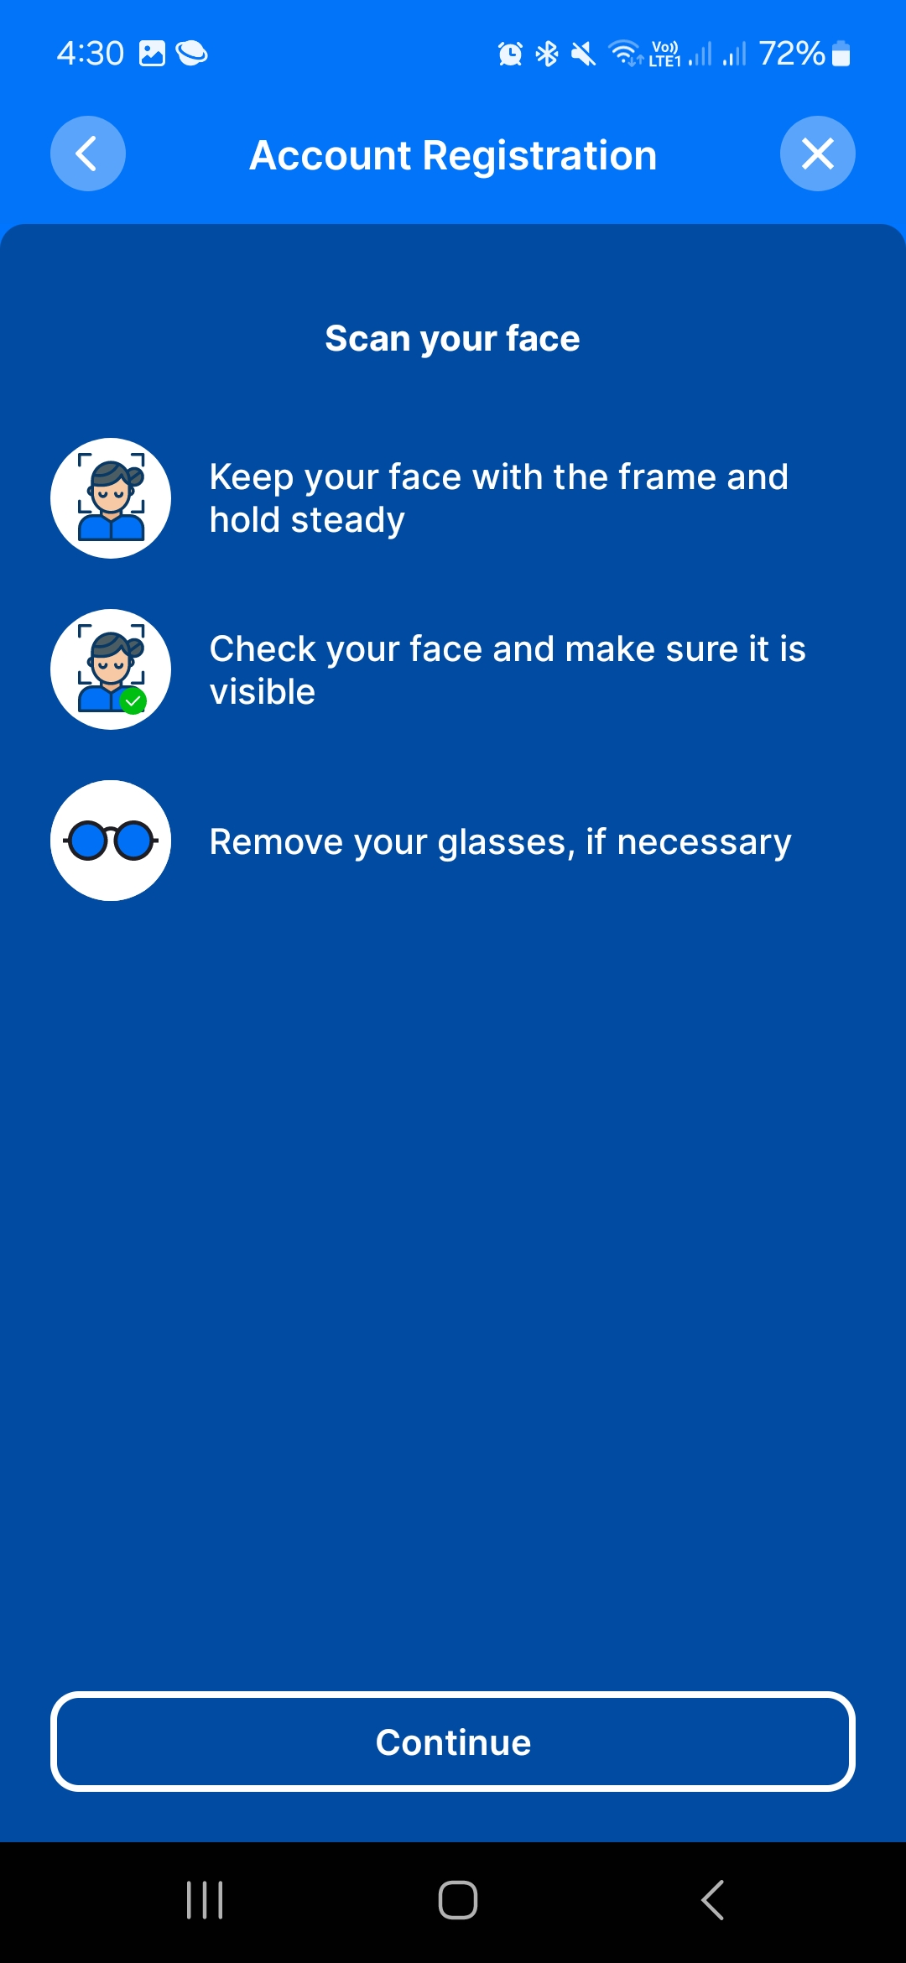
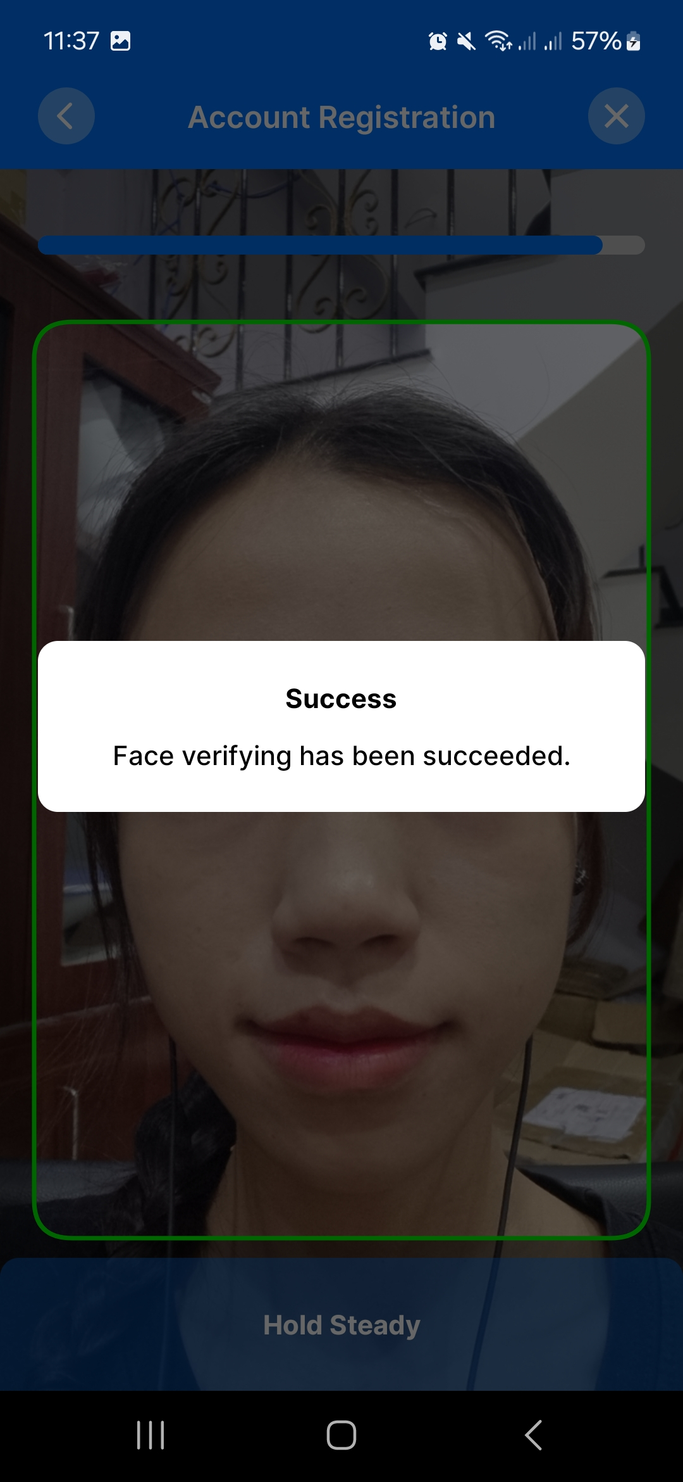
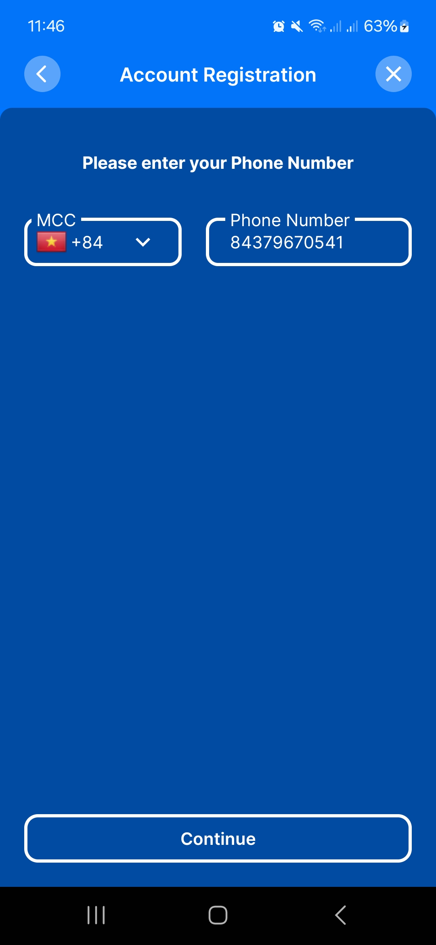
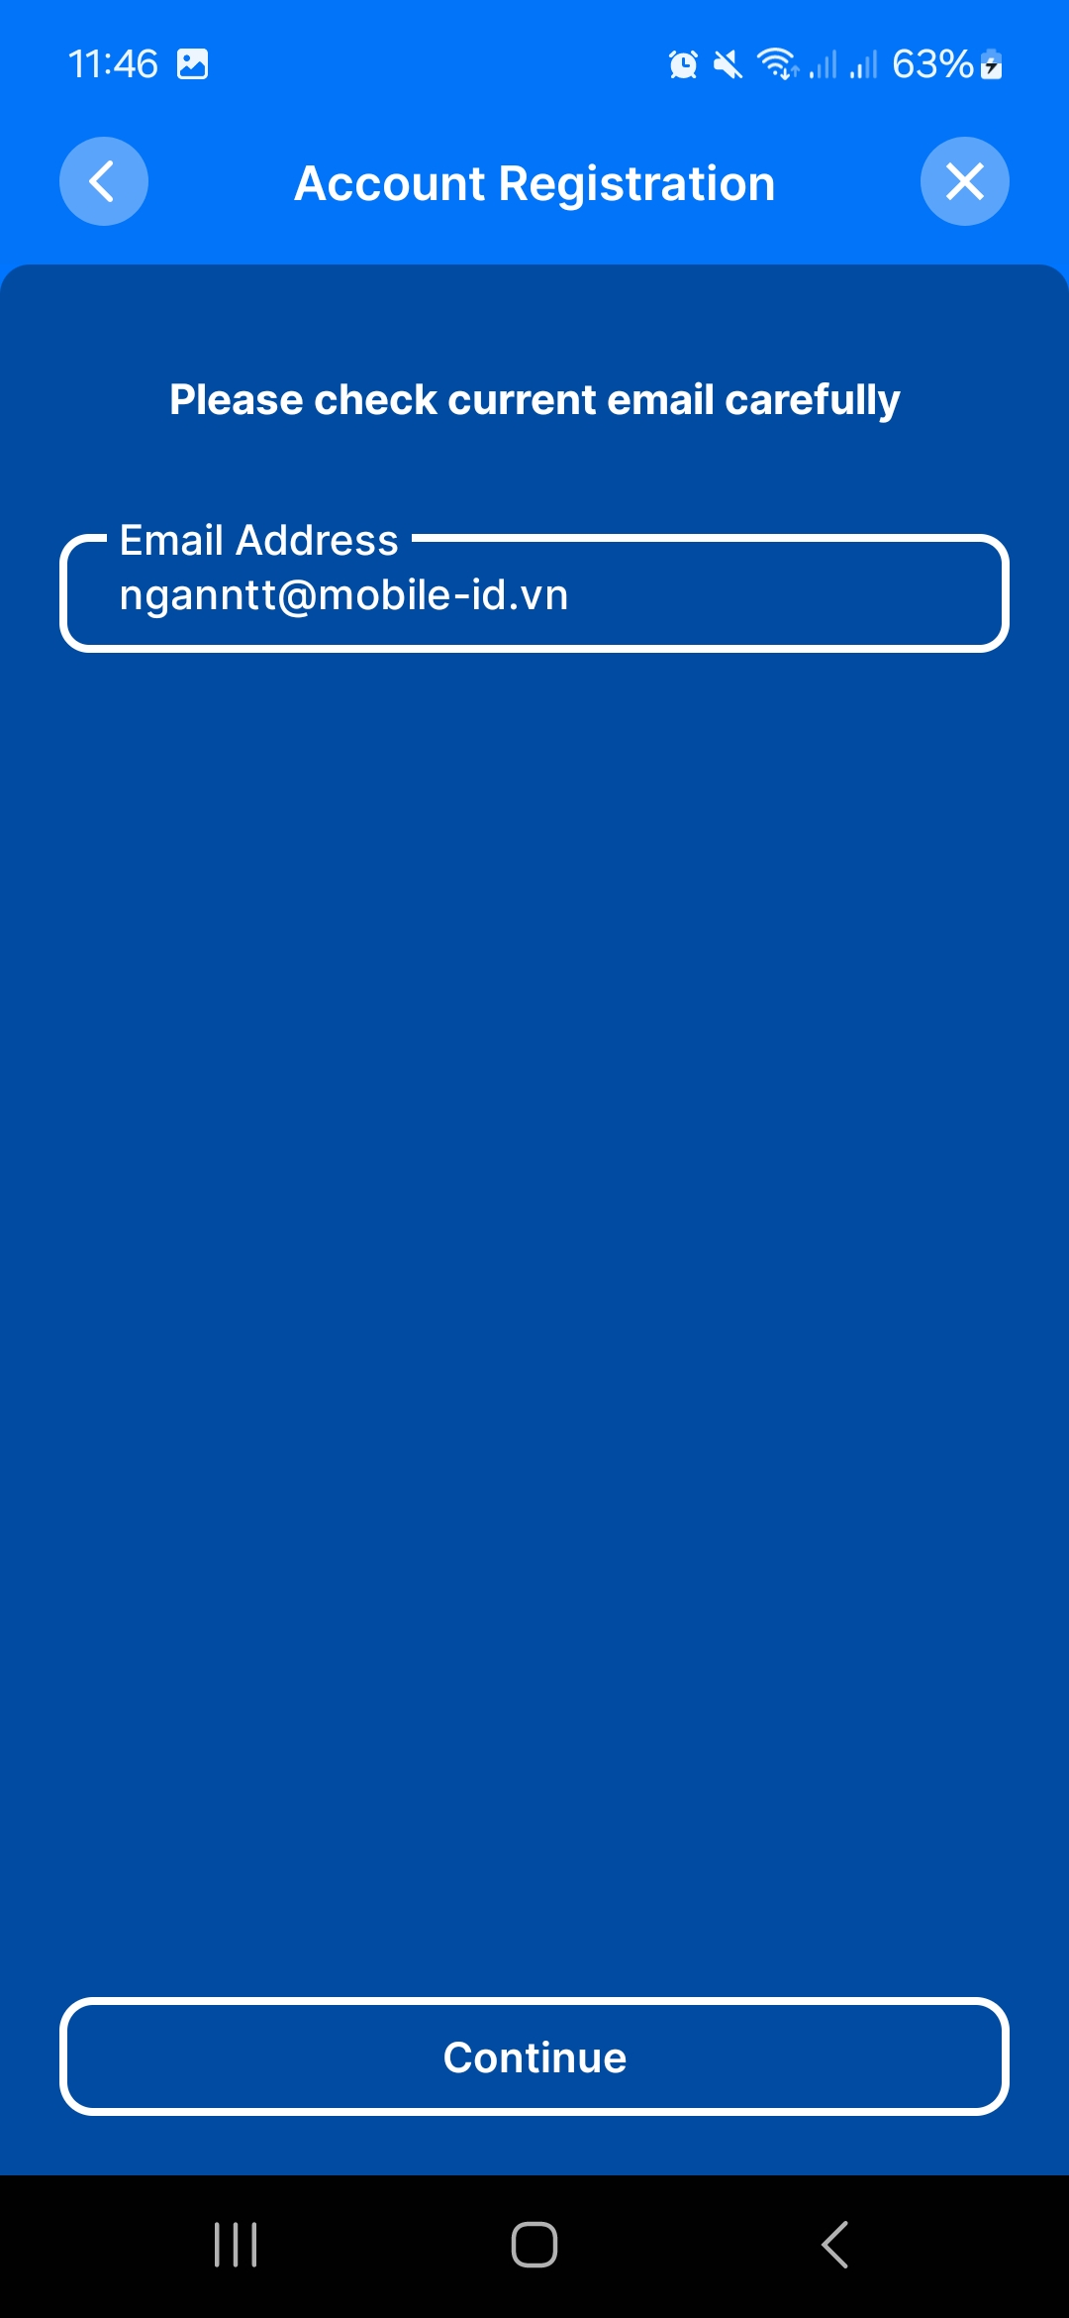
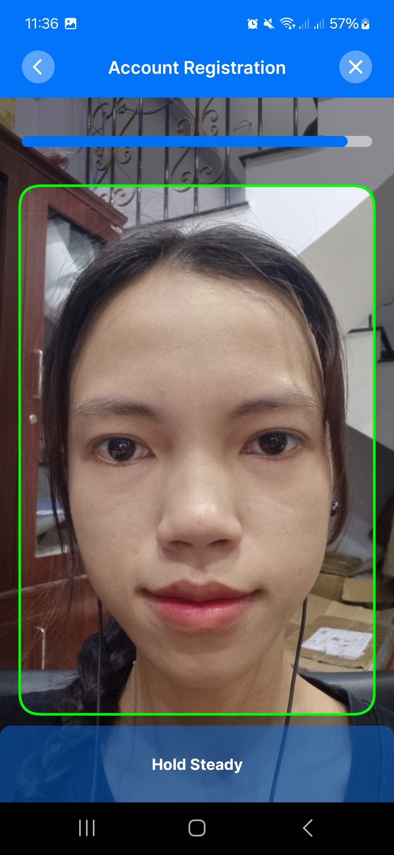
CREATE AN ACCOUNT ON EIDBANK MOBILE APP
Create step by step follow to the App instruction

Slide 22
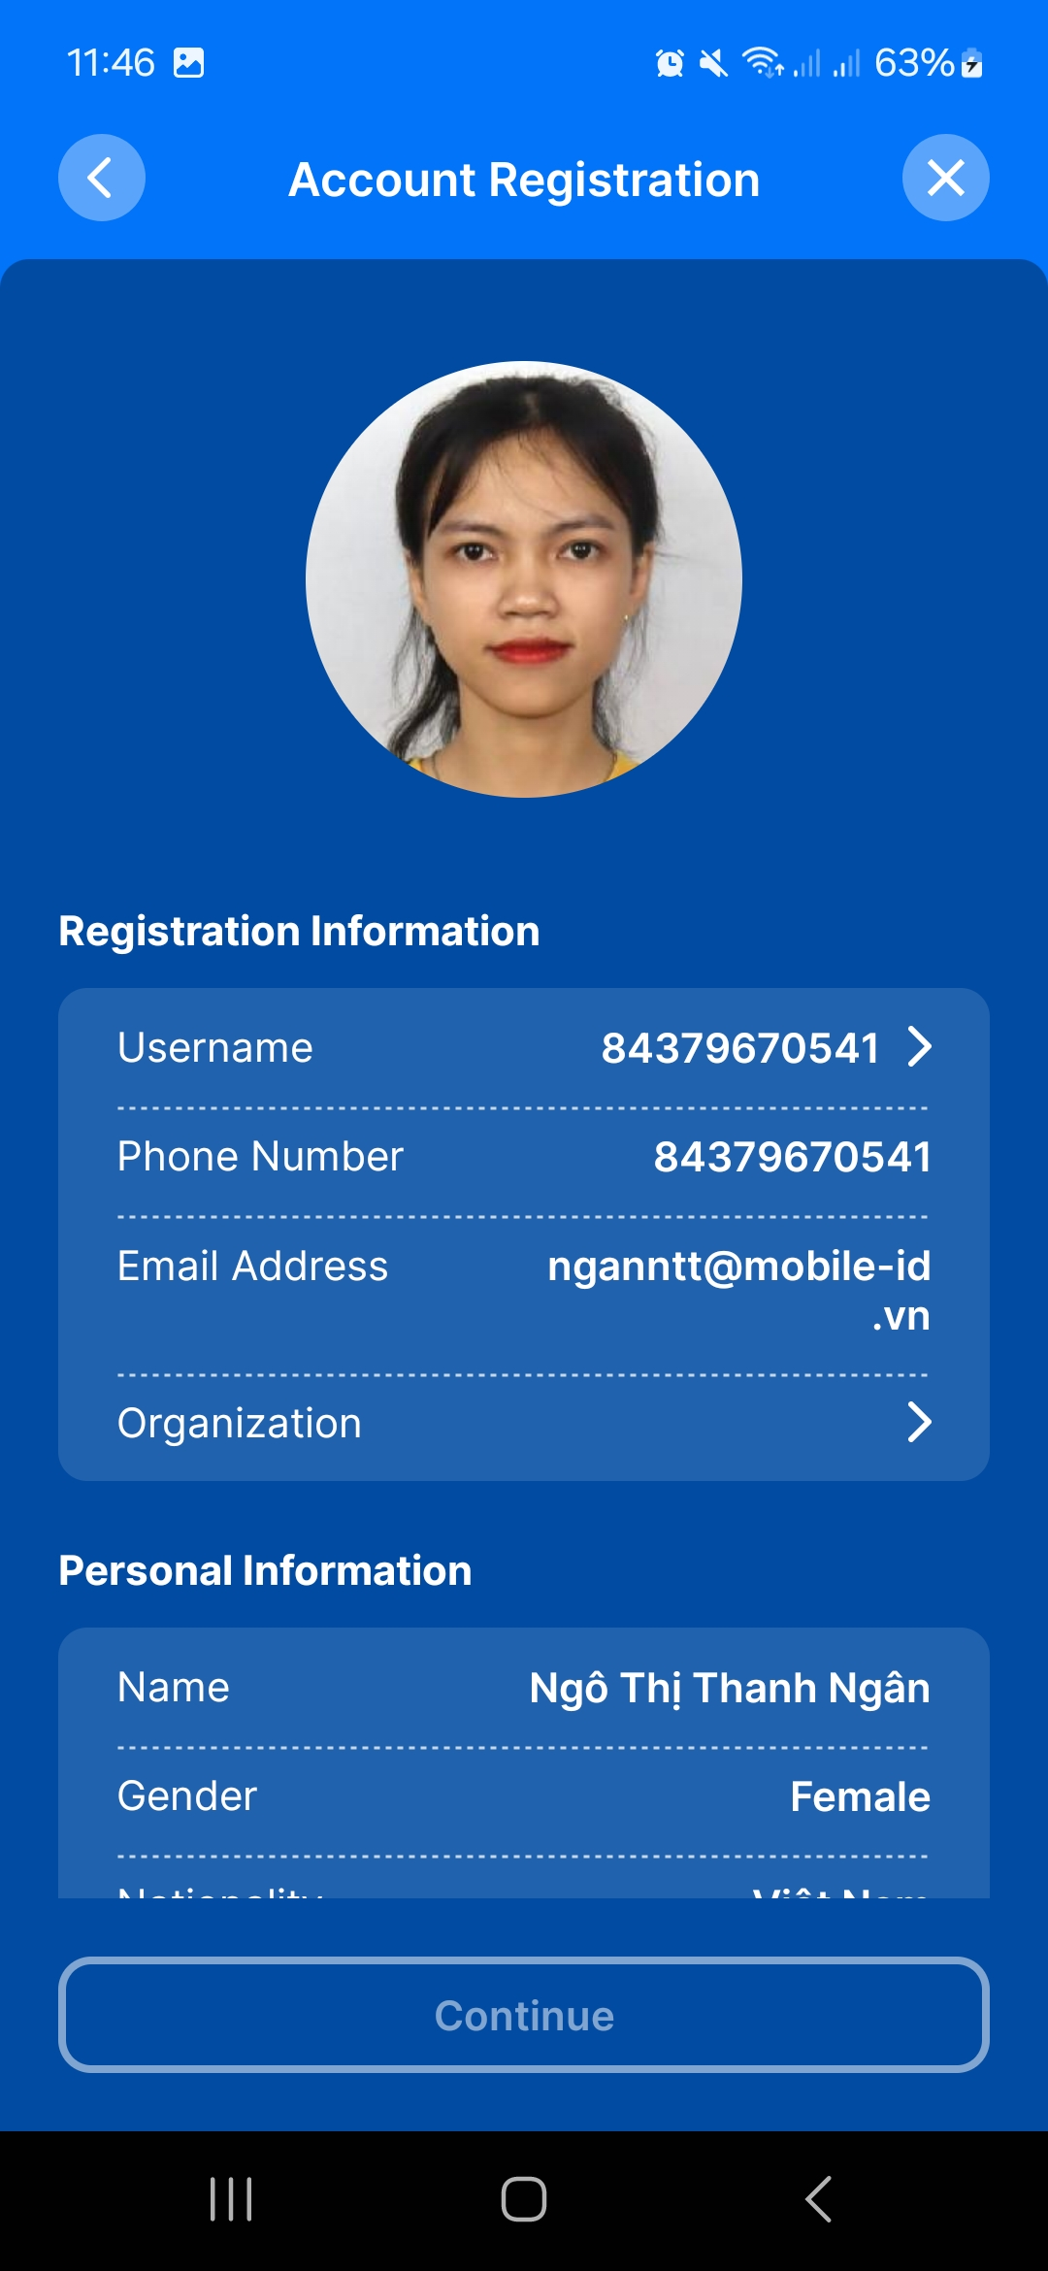
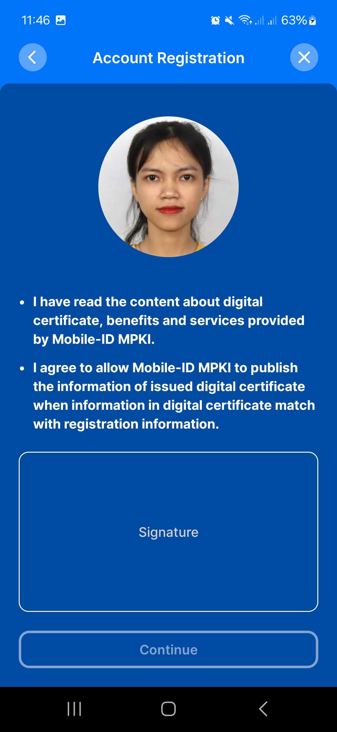
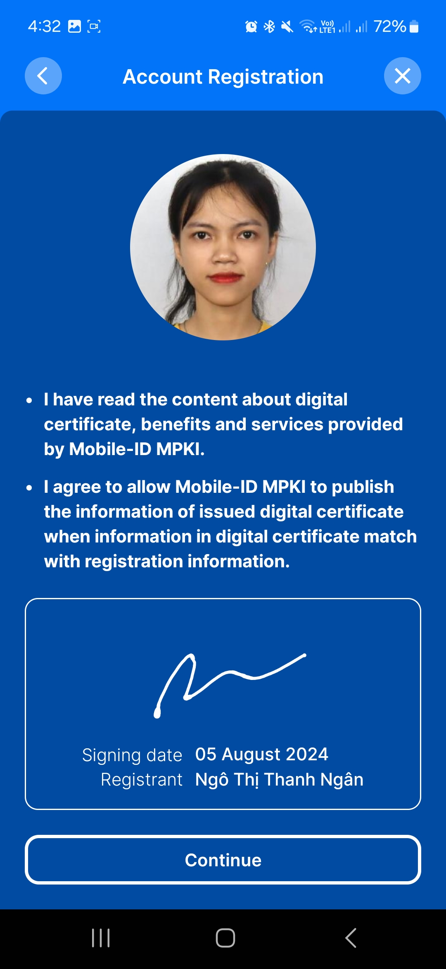
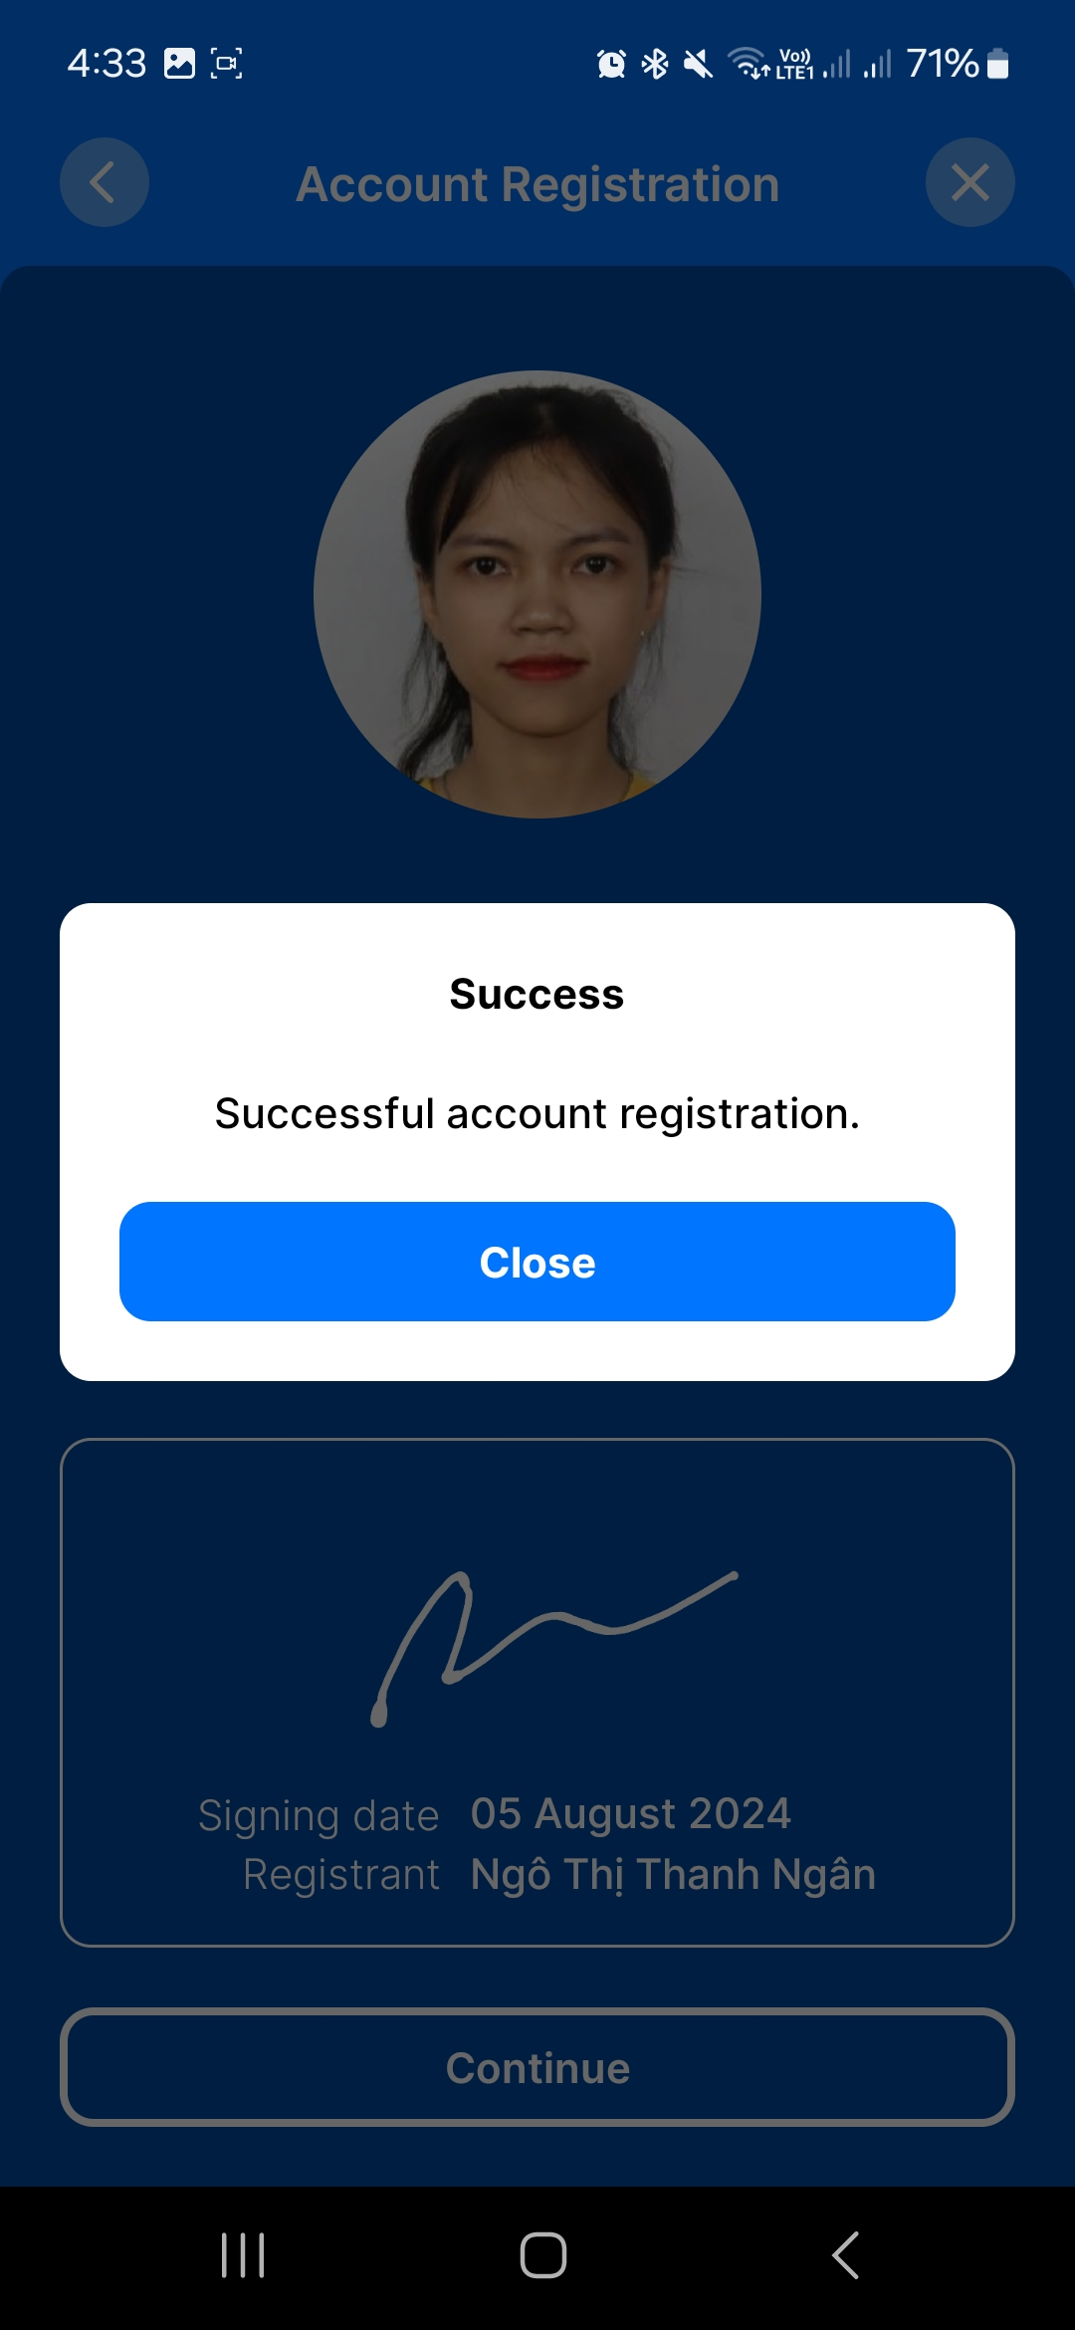
CREATE AN ACCOUNT ON EIDBANK MOBILE APP
The account created was completed

Slide 23

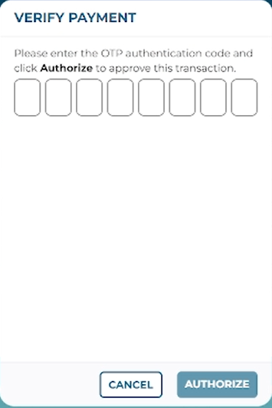
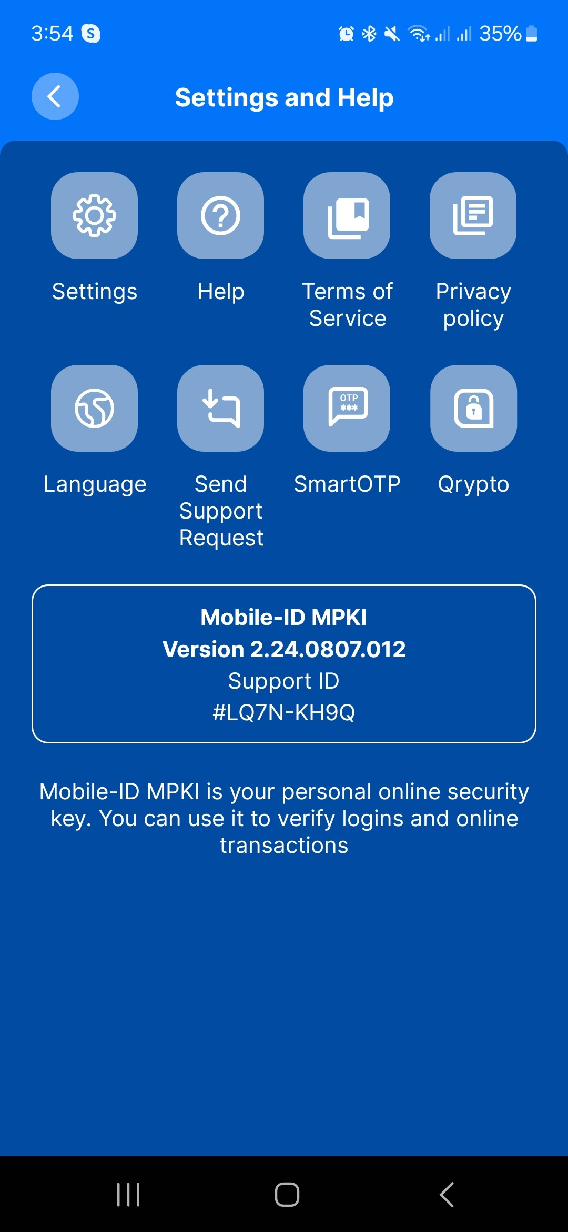
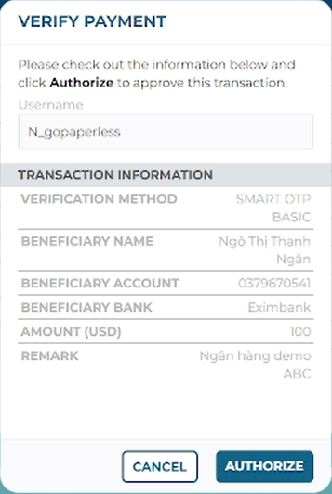
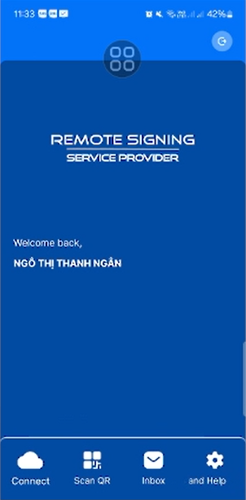
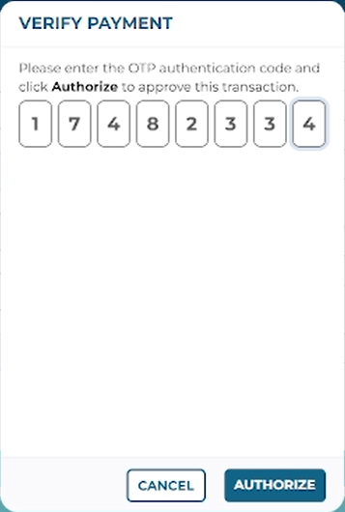
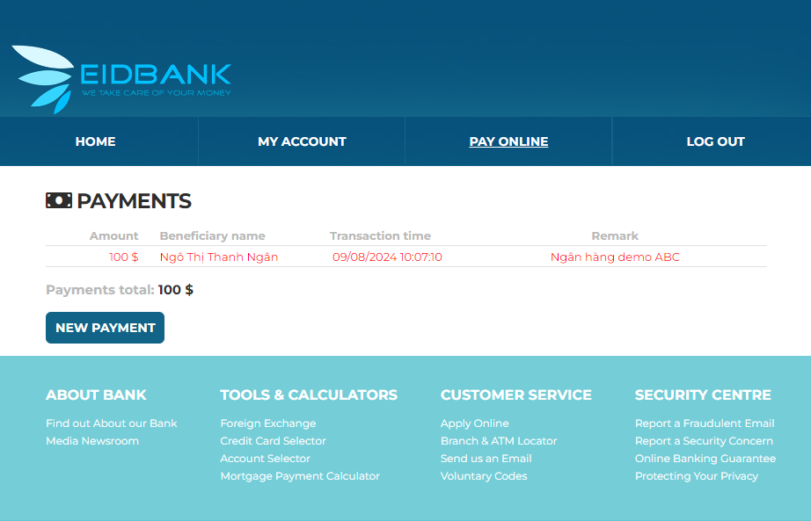
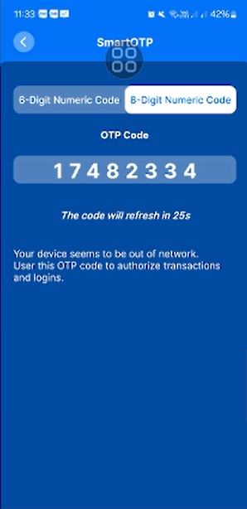
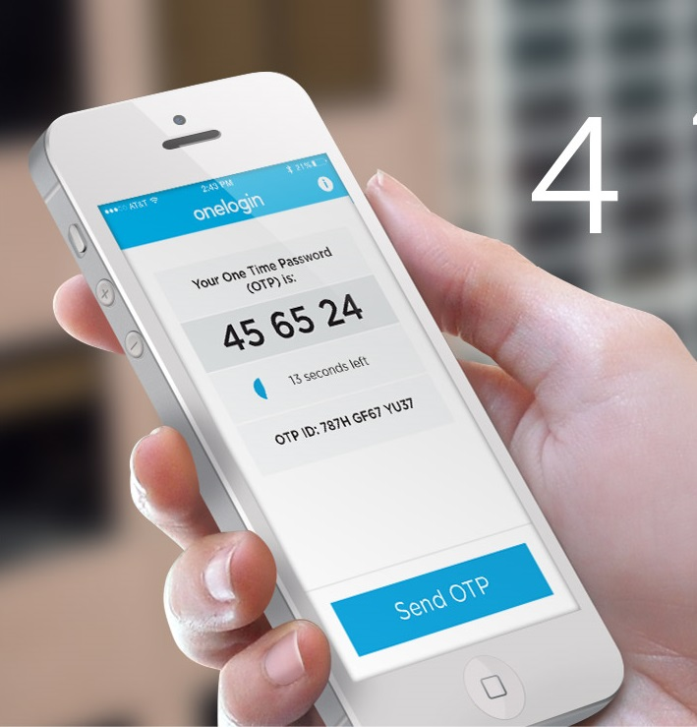
SMART OTP BASIC
Pay online: 100.00$ or more
TRUSTED HUB
e-Banking (IB/MB)

Slide 24
SMART OTP ADVANCE
FAST REMOTE LOGON
Mobile OTP frees your pocket and keychain from bringing real physical OTP tokens by simply installing an application in your smart phone
With fast remove logon, you do not even need to enter the OTP code manually. The only thing you need to do on your mobile application is click “logon” when the request comes. All of the OTP exchanges with authentication server will be conducted invisibly

Slide 25








SMART OTP ADVANCE – OTP CODE
Pay online: 500.00$ or more
TRUSTED HUB
e-Banking (IB/MB)

Slide 26











SMART OTP ADVANCE – NO OTP CODE
Pay online: 500.00$ or more
TRUSTED HUB
e-Banking (IB/MB)

Slide 27












SMART OTP ADVANCE – QR CODE
Pay online: 500.00$ or more
TRUSTED HUB
e-Banking (IB/MB)

Slide 28















SMART OTP ADVANCE – QR CODE
Pay online: 500.00$ or more
TRUSTED HUB
e-Banking (IB/MB)

Slide 29





















SMART OTP ADVANCE & BIOMETRIC
Pay online: 1,000.00$ or more
TRUSTED HUB
e-Banking (IB/MB)

Slide 30











EID – FINGERPRINT & ID CARD
Pay online: 5,000.00$ or more
Start CheckID Client App
TRUSTED HUB
e-Banking (IB/MB)

Slide 31









REMOTE SIGNING
Pay online: 10,000.00$ or more
TRUSTED HUB
e-Banking (IB/MB)

Slide 32













REMOTE SIGNING & BIOMETRIC
Pay online: 50,000.00$ or more
TRUSTED HUB
e-Banking (IB/MB)

Slide 33




User Experience
Multiple algorithms supported
Security with a harden shell
PKI FORM FACTORS
Compact and portable
Flexible customize
Cryptographic APIs
Create your own PKI services.
Microsoft Crypto API (CAPI)
PKCS #11
PC/SC

Slide 34
User Experience
1
This is the cost-effective solution with fully integrated variety authentication/validator methods
2
It is suitable for SME with the easy to integration, the cheaper budget, the totally support from security expert
3
We connected all of Certification Authority service providers such as VNPT-CA, FPT-CA, SAFE-CA, ....

Slide 35







PKI TOKEN
CA
Pay online: 100,000.00$ or more
TRUSTED HUB
e-Banking (IB/MB)

Slide 36
ADVANCED FEATURES

Slide 37






Advantages
WHAT TRUSTED HUB PROVIDES?
SECURITY
COST EFFECTIVE
Burn seed either by TRUSTED HUB with strict security policy or by customers themselves
Low cost with high quality
QUICK RESPONSE
TAILORED
Response in time
Flexible customization suits all your needs

Slide 38





Advantages Features
Document Signing (XML, PDF, Office, …)
Document Validation
Backend Solution (Back Office Portal)
iOS 13 or newer
Space ~ 16GB
Android 7.0 or newer
Space ~95 MB for Android 4.x, 16 MB for Android 5.x

Slide 39





Thank you!
MOBILE-ID TECHNOLOGIES & SERVICES JOINT STOCK COMPANY
Level 9, Thuy Loi 4 Building, Ward 13, Binh Thanh District, HCM City
028 3622 2982
info@mobile-id.vn

